Slide 1

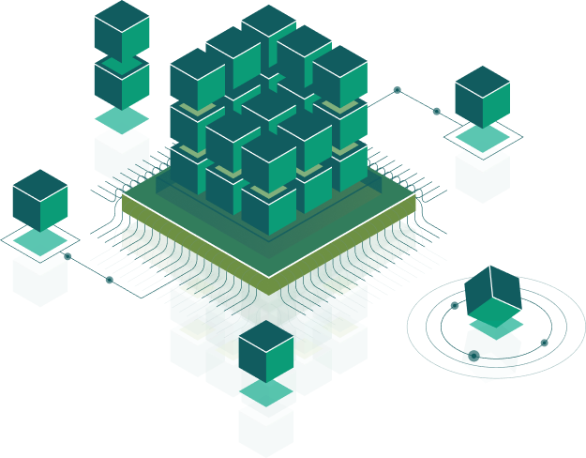
Software best practices
Design patterns
Speaker:
Andriy

Slide 2

Programming Paradigms - way to classify programming languages based on their features
Best Practices and Principles - it is a number of specific rules and recommendations, which engineers need to be followed during program implementation if they want to write beautiful, understandable and maintainable code.
Design Patterns- is a general, reusable solution to a commonly occurring problem

Slide 3
OOP

Slide 4
OOP
object-oriented programming (OOP) is a programming paradigm based on the concept of "objects"
Class
Abstraction
Object
Encapsulation
Inheritance
Field
Functions
Polymorphism

Slide 5
Abstraction
applying abstraction means that each object should only expose a high-level mechanism for using it.

Slide 6
Encapsulation
encapsulation is achieved when each object keeps its state private, inside a class.

Slide 7
Inheritance
the child class reuses all fields and methods of the parent class (common part) and can implement its own (unique part).

Slide 8
Polymorphism
the condition of occurring in several different forms

Slide 9
Best Practices

Slide 10
Keep It Simple
code should be simple, without any complicated structures if possible
complexity breeds bugs
complicated maintenance of the code
overcomplicate debugging
overcomplicated solutions require additional time and effort
difficult for another programmer to understand
implement only what you need in the first place, and in the future, if necessary,
increase the functionality
do not add all possible methods to the class and implements them,
while in the future it may even never use them

Slide 11
Occam’s Razor
Entities are not to be multiplied without necessity
no need to create extra entities without the need for them
you always need to think first about the benefits of adding one more method/class etc
if you add one more method/class/tool/process/etc and don't get any benefits
but increasing complexity then what's the point?

Slide 12
Don’t Repeat Yourself
if any code is found in the listing more than once, then it should be placed in a separate method.
if necessary make even small corrections into source code, you need to change the same code
in several places
you or another developer may accidentally miss one of the fixes and face subsequent errors
in the application.

Slide 13
Avoid Premature Optimization
premature optimization is the root of all evil (or at least most of it) in programming
everything has its time
development of optimized code requires more time and effort of the developer
at first, it is more profitable to use simple, but not the most optimal solutions
the requirements may change and the code will go to the garbage

Slide 14
Architectural Principles

Slide 15
S.O.L.I.D.
“SOLID” is actually a group of object-oriented design principles used by individual developers when writing code. Each letter in “SOLID” represents one of the principles
single responsibility states that every module or class should have responsibility over a single part
of the functionality provided by the software and that responsibility should be entirely encapsulated
open-closed states that software entities (classes, modules, functions, etc.) should be open for
extension, but closed for modification
Liskov substitution states that the inherited class should complement, not replace,
the behavior of the base class
interface segregation states that no client should be forced to depend on methods it does not use
dependency inversion - high-level modules should not depend on low-level modules.
Both should depend on abstractions. Abstractions should not depend on details.
Details (concrete implementations) should depend on abstractions.

Slide 16
Single Responsibility

Slide 17
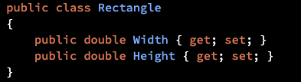
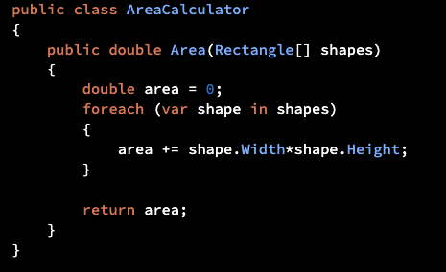
Open Close

Slide 18
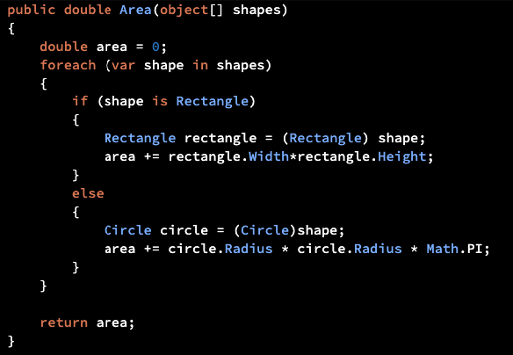
Open Close
That is, AreaCalculator isn’t closed for modification as we need to change it in order to extend it. Or in other
words: it isn’t open for extension.

Slide 19
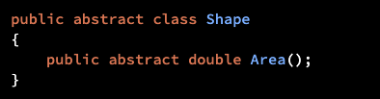
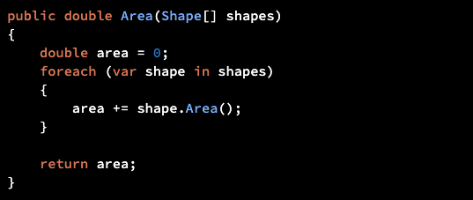
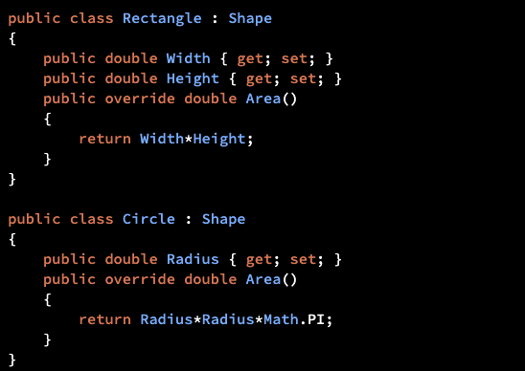
Open Close

Slide 20
Liskov substitution

Slide 21
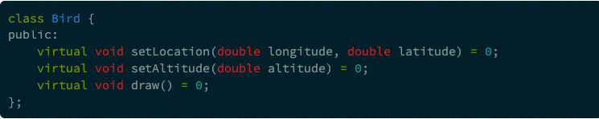
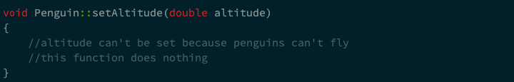
Liskov substitution
If an override method does nothing or just throws an exception, then you're probably violating the LSP.

Slide 22
Interface segregation

Slide 23
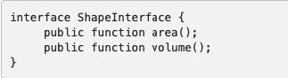
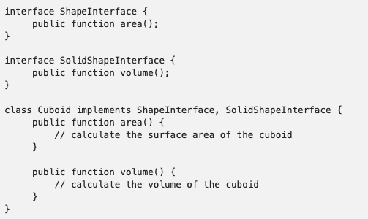
Interface segregation

Slide 24
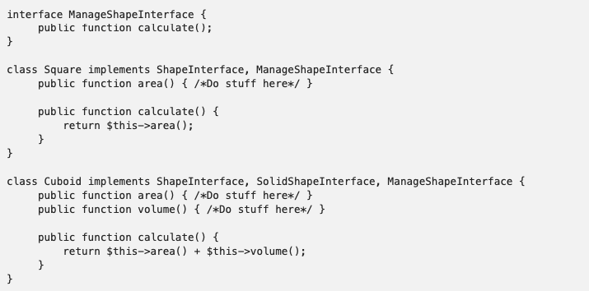
Interface segregation

Slide 25
Dependency Inversion
high-level modules should not depend on low-level modules.
Both should depend on abstractions.
Abstractions should not depend on details.
Details (concrete implementations) should depend on abstractions.

Slide 26
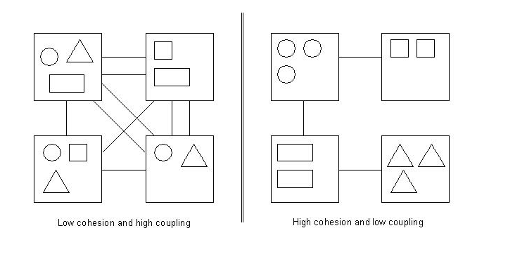
Low coupling High cohesion
low coupling is in the context of two or many modules. If a change in one module results in many
changes in other module then they are said to be highly coupled.
high cohesion- put the similar things together. So a class should have method or behaviors to do related job.

Slide 27
Design Patterns

Slide 28
Software design pattern
creational patterns
Abstract factory
Prototype
Singleton
structural patterns
Adapter
Proxy
Decorator
behavioral patterns
Chain of responsibility
Observer
Iterator

Slide 29
Abstract factory
produce families of related objects without specifying their concrete classes

Slide 30
Prototype
specify the kinds of objects to create using a prototypical instance, and create new objects from the
'skeleton' of an existing object

Slide 31
Singleton
ensure a class has only one instance, and provide a global point of access to it

Slide 32
Adapter
convert the interface of a class into another interface clients expect

Slide 33
Proxy
provide a surrogate or placeholder for another object to control access to it

Slide 34
Decorator
attach additional responsibilities to an object dynamically keeping the same interface. Decorators
provide a flexible alternative to subclassing for extending functionality

Slide 35
Chain of responsibility
chain the receiving objects and pass the request along the chain until an object handles it

Slide 36
Observer
define a subscription mechanism to notify multiple objects about any events that happen
to the object they’re observing

Slide 37
Iterator
lets you traverse elements of a collection without exposing its underlying representation (list, stack, tree, etc.)

Slide 38

Thank you!

